Slide 1

Unit 04.04.03
CS 5220:
COMPUTER COMMUNICATIONS
OpenFlow, SDN, and NFV
XIAOBO ZHOU, Ph.D.
Professor, Department of Computer Science

Slide 2
OpenFlow
An open standard to deploy innovative protocols in production networks
  provides a standardized hook to allow us to run experiments, without requiring vendors to expose the internal workings of their network devices
The standard communications interface defined between the control and forwarding layers of an Software-Defined-Network (SDN) architecture

Slide 3
The Evolution
2010
2011
2012
2013
OpenFlow
SDN 1.0
NFV
SDN 2.0
SCOPE

Slide 4
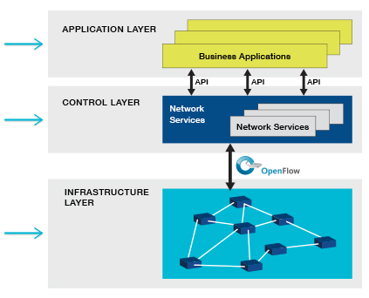
OpenFlow Architecture
Separate datapath and control path
Programmability
  Enable innovation/differentiation
  Accelerate new features and services introduction
Abstraction
  Decouple: Hardware & Software
  Control plane & forwarding,
  Physical & logical configuration
Centralized Intelligence
https://www.opennetworking.org/sdn-resources/openflow

Slide 5
General Misconceptions
SDN is:
  OpenFlow?
  Standard southbound API?
  Centralization of control plane?
  Separation of control and data plane?
In reality, SDN is a framework to solve a set of problems while OpenFlow is an open API that provides a standard interface for programming the data plane switches.
Is SDN a mechanism?

Slide 6
What is SDN?
Centralization of control of the network via,
Separation of control logic to off-device compute, that
Enables automation and orchestration of network services via,
Open programmatic interfaces.

Slide 7
SDN Benefits
Efficiency
  optimize existing applications, services and infrastructure
Scalability
  rapidly grow existing applications and services
Innovation
  create and deliver new types of applications and services and business models

Slide 8
Why do we need SDN?
Network virtualization (datacenter and cloud)
Orchestration (cloud)
Programmable (enterprise)
Dynamic scaling (cloud)
Automation – (datacenter and cloud)
Visibility - monitor resources, connectivity
Performance (datacenter and cloud)
Multi-tenancy (data center and cloud)
Service integration (Enterprise)

Slide 9
Network Function Virtualization (NFV)
Decouples functions like a firewall or encryption from dedicated hardware and moves the function to virtual servers.
Refers to the strategy of virtualizing network functions moving from separate proprietary pieces of hardware to software running on virtual servers using standard hardware.

Slide 10
NFV Innovations
1. Standard API’s between modules
2. Implementation in virtual Machines
3. Network function modules
4. Software implementation of network

Slide 11
NFV and SDN Relationship
Concept of NFV originated from SDN
NFV and SDN are complementary
Both have similar goals but different approaches
Virtualization alone provides many of the required feature for both NFV and SDN

